Slide 1



Department of Computer Science and Engineering
EXPERTISE WITHOUT TOKENS TO PROTECT BANKING TRANSACTIONS AS GATEWAY
SAKTHI ARUMUGARAJ [211419104227] SWARNAMALYA.N [211419104279]
Guide
Mrs.D.Jennifer ME,(PhD)
Coordinator
Dr.K.VALARMATHI ME, PhD

Slide 2
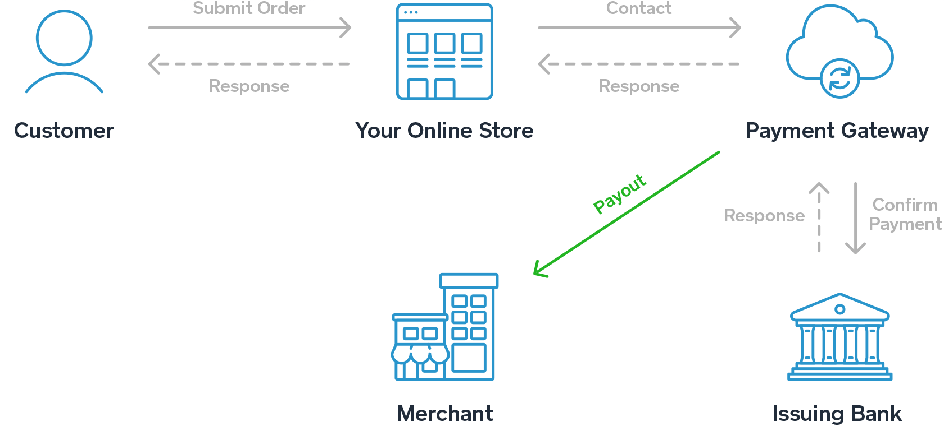
Introduction
Payment gateways allow merchants to accept payments by connecting customers and merchant account providers.
The payment switch is part of the payment gateway and is responsible for making sure incoming payment requests (transactions) are directed to the right place.
When the gateway receives a payment request, the transaction is routed to the payment switch ,then the switch routes the transaction to the correct issuing bank for approval.
The transaction flow is the same whether you’re using a physical or virtual payment gateway, but mobile and online payments use digital capture files

Slide 3
Objective of the Project
The primary role of the payment gateway is to support the transaction between you and your clients. Remember, without a payment gateway's approval, the transaction procedure will not complete, and you won't get the cash.
Online Payment Gateway Integration is more than just a medium to receive, store, and transmit the data of customers. Payment gateways say about your website, it ensures others that it is a secured one.
The main reason to use secure payment gateway is to avoid fraudulent transactions

Slide 4
Literature Survey
S.NO | TITLE | AUTHORS | ADVANTAGES | DRAWBACKS
1 | The Role of Technology in Improving the Customer Experience in the Banking Sector: A Systematic Mapping Study,2022 | Roberto Vergallo Luca Mainett | Technology improved the customer experience in the banking sector. | A new payment scheme is needed to reduce double spending in a sustainable and energy efficient way.
2 | Banking on Blockchain: An Evaluation of Innovation Decision Making,2022 | Priya D. Dozier TroyA. Montgomery | Organizations in the financial services industry are evaluating blockchain to determine its value. | Organizations can leverage this article to support innovation activities.

Slide 5
Literature Survey
3 | Simple and secure reformation-based password scheme,2021 | Mushtaq Ali , Amanullah Baloch, Abdul Waheed ,Mahdi Zareei Rimsha Manzoor, Hassam Sajid, and Faisal Alanazi | The proposed scheme uses two different numeric codes for textual passwords, improving security and usability. | We aim to improve usability and Security by Providing a single user interface and using the same password.
4 | Banking Digitalization: (Re)Thinking Strategies and Trend using Problem Structuring Methods,2019 | João F. C. Rodrigues, Fernando A. F. Ferreira , Leandro F. Pereira, Elias G. Carayannis , and João J. M. Ferreira | Banking digitalization is influenced by clients, socioeconomic and human factors, Technological factors ,profitability,and risks and security. | The proposed framework emphasizes the constructivist, process-oriented nature of digital realities.

Slide 6
Literature Survey
5 | RONFC: A Novel Enabler- Independent NFC Protocol for Mobile Transactions 2019 | Ismail Turk, Pelin Angin and Ahmet Cosar | RONFC is a new NFC protocol that enables mobile transactions without dependency on NFC Enablers. | Card Providers (CP) are the main card issuers.
6 | Optimal Staffing Policy in Commercial Banks Under Seasonal Demand Variation 2019 | Yuanqiao Chen , Xiaoqiang Zhang , Bomin BIian , and Haohua Li | We develop a seasonal staffing method to help banks find the optimal staffing policy under seasonality. | The single-system model is not suitable for finding the global optimal solution.

Slide 7
Problem Statement
We have not performed pure performance simulations due to redundant solutions.
The centralized solution is of constant complexity while the decentralized solution is at least linear. As such, the performance of the centralized solution will eventually outperform the decentralized solution.
While it could be difficult to justify a decentralized SG as a replacement for better performing centralized SG in developed countries with proper energy infrastructure and privacy and security laws; there are extreme environments where a decentralized solution might be preferred (e.g., undeveloped countries, conflict zone).

Slide 8
Existing System
The existing system implements online banking for online money transaction.
At first it creates standard interface between the clients and the bank. By using this portal any client who maintain accounts in various banks can directly log on to online Banking System Interface and make any kind of transactions.

Slide 9
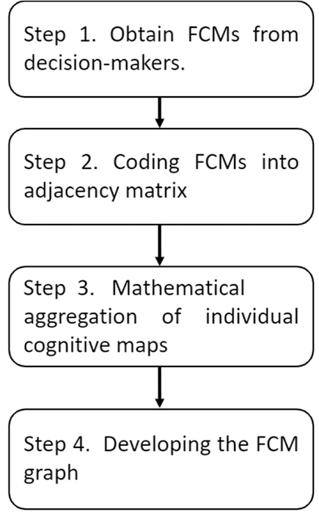
Existing Algorithm
FUZZY COGNITIVE MAP ALGORITHM:
A fuzzy cognitive map (FCM) is a cognitive map within which the relations between the elements (e.g. concepts, events, project resources) of a "mental landscape" can be used to compute the "strength of impact" of these elements. Fuzzy cognitive maps were introduced by Bart Kosko, Robert Axelrod

Slide 10
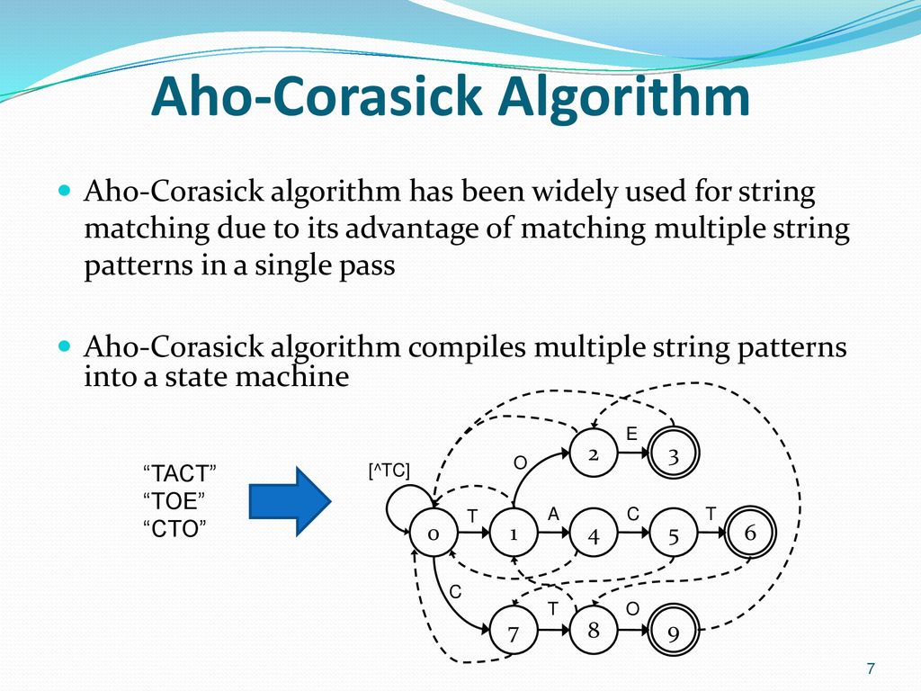
Existing Algorithm(contd)
AHO-CORASICK ALGORITHM
The Aho–Corasick algorithm is a string-searching algorithm
invented by Alfred V. Aho and Margaret J. Corasick in 1975. It is a kind of dictionary-matching algorithm that locates elements of a finite set of strings (the "dictionary") within an input text. It matches all strings simultaneously.

Slide 11
Proposed System
Proposed system can develop recommendations for the protection of information in geographically-distributed structures, typical of modern banks, based on the cloud.
Each block stores information on addresses, transactions, account balances
After creating a new block, all transactions that claim to be included in it are checked by this protocol for legality, and the transactions that violate the balance conditions are discarded.

Slide 12
Proposed System(contd)
The hash value of transactions calculated by the algorithm BVCS, and this hash value is used for block hashing.
In addition it is used to check the integrity of the data and get a unique identifier.
Each every block contains previous block hash value. This hash value generated by using the BVCS Algorithm.

Slide 13
Proposed Algorithm
VISUAL CRYPTOGRAPHY:(BVCS)
STEPS INVOLVED :
1. Start
2. Take any secret message (text, picture etc.) in image format.
3. Perform visual cryptography encryption technique
4. Perform Pixel expansion
5. Generate shares,
6. Save all the generated shares,
7. Stack all or the defined number of shares.
8. Stop.

Slide 14
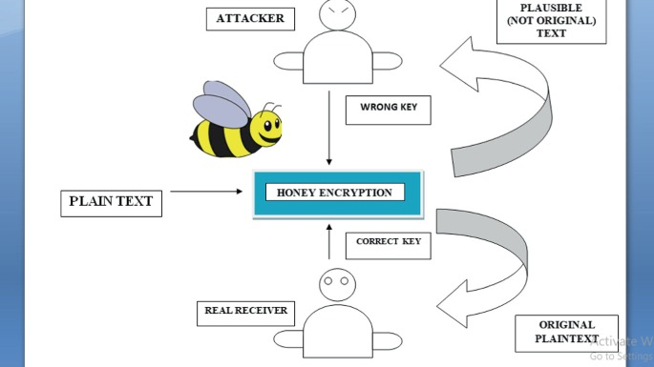
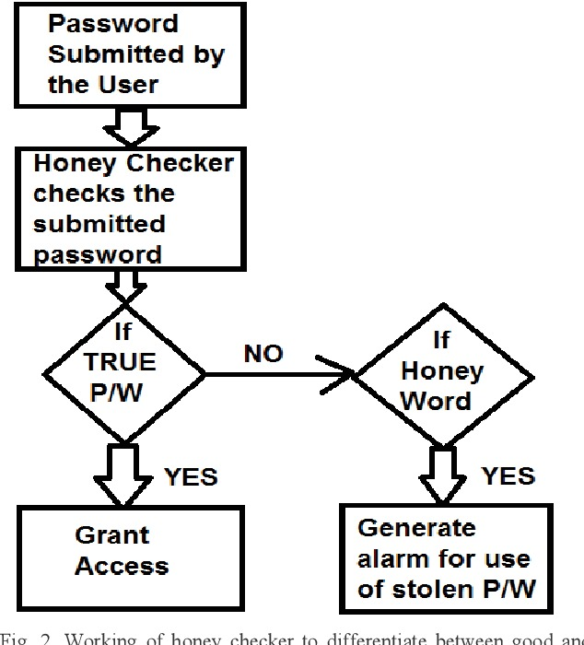
Proposed Algorithm(contd)
HONEY ENCRYPTION
ALGORITHM:

Slide 15
Software & Hardware used
Operating System - Windows7/8/10
Front End - HTML, Java, Jsp
Scripts - JavaScript.
Server side Script- Java Server Pages.
Database - My sql
Database Connectivity - JDBC.
Processor - Pentium –III
RAM - 4 GB
Hard Disk - 260 GB
KeyBoard-StandardWindows Keyboard
Mouse - Two or Three Button Mouse
Monitor - SVGA

Slide 16
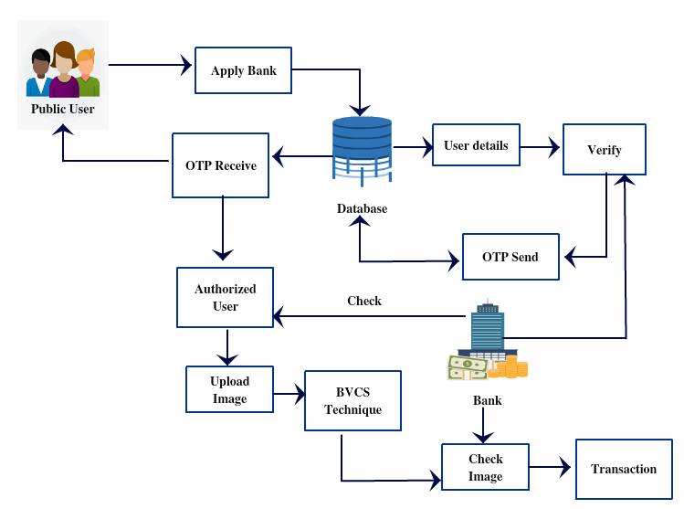
Architecture

Slide 17
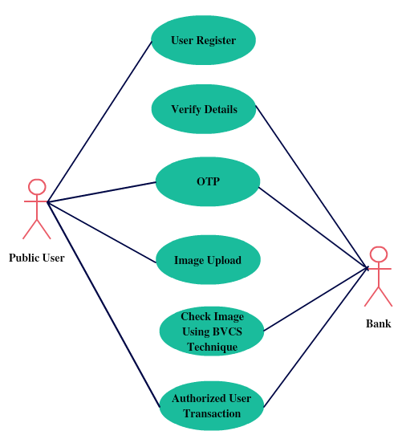
System Design – Use Case Diagram

Slide 18
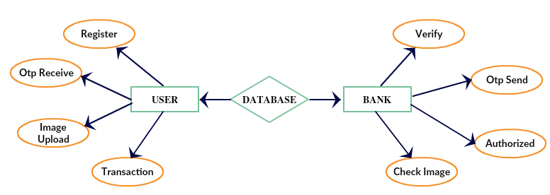
System Design –ER Diagram

Slide 19
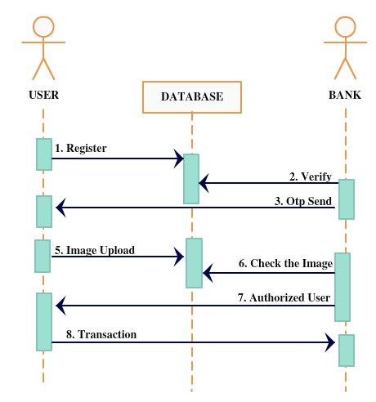
System Design –Sequence Diagram

Slide 20

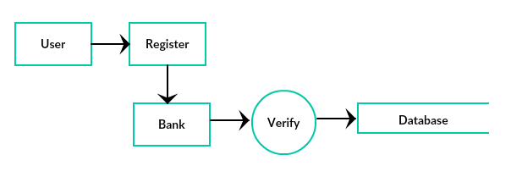
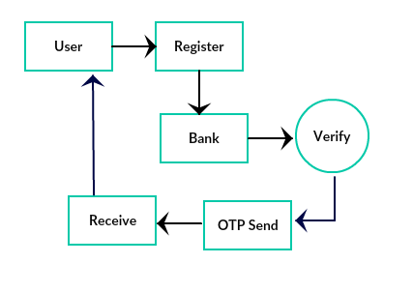
System Design-Data Flow Diagram
Level-0
Level-1
Level-2

Slide 21
Module Description
Public User registration
Bank Verification
BVSC
Image authenticate(Matching and Validation)

Slide 22
Module Description
Public User registration:
In this module user have to register by giving the information about the user in the application, before login. Without login user can’t view the items are any details in the application. A public user can registered to this bank application so they can access . A registered user may also refer to an individual who is signed up for a service.
2. Bank Verification:
In this module, the banker will verify the user details by viewing the user registration detail and the banker send a OTP (One Time Password) to the user, then the user can access the web application on banking sector to transaction

Slide 23
Module Description
3.BVSC (Binocular VCS):
In this module the user will upload the image to authenticate The BVCS technique will check the image. The slight differences between the two images-seen from slightly different positions-make it possible to perceive distances between objects in what is known as depth perception.
4.Image authenticate(Matching and Validation):
In this module the bank will authenticate the user image to check the user is authorized or not. If the image is correct the only the user can able to do the transaction process if the image is not same image the user will be a unauthorized person so the user cannot do any transaction process.

Slide 24
Testcases/Result
TEST CASE ID | TEST CASE/ACTION TO BE PERFORMED | EXPECTED RESULT | ACTUAL RESULT | PASS/FAIL
1 | User enter mail id and password | Display Login page | Display Login page | Pass
2 | Enter the Bank details in bank login | Display Bank page | Display Bank page | Pass
3 | Enter the Admin page | Display Admin page and admin enter mail id and password | Display Admin page and admin enter mail id and password | Pass
4 | Bank Login | Check the entered details and accept | Check the entered details and accept | Pass
TEST CASE ID
TEST
CASE/ACTION
TO BE
PERFORMED
EXPECTED
RESULT
ACTUAL RESULT
PASS/FAI
L
1
User enter mail
id and
password
Display Login
page
Display Login page
Pass
2
Enter the
Bank details in
bank login
Display Bank
page
Display Bank page
Pass
3
Enter the Admin
page
Display Admin
page and admin
enter mail id and
password
Display Admin
page and admin
enter mail id and
password
Pass
4
Bank Login
Check the entered
details and accept
Check the entered
details and accept
Pass
5
Public user
Login
Check the entered
details and accept
Check the entered
details and accept
Pass

Slide 25
Testing /Performance Evaluation / Results
5 | Public user Login | Check the entered details and accept | Check the entered details and accept | Pass
6 | Image Verification page | Upload the image from mail received | Upload the image for mail received | Pass
7 | Key value | Key value appears | Key value appears | Pass
8 | Transaction Page | After entering the key value and enter the amount | After entering the key value and enter the amount | Pass
Slide 18 to 19

Slide 26
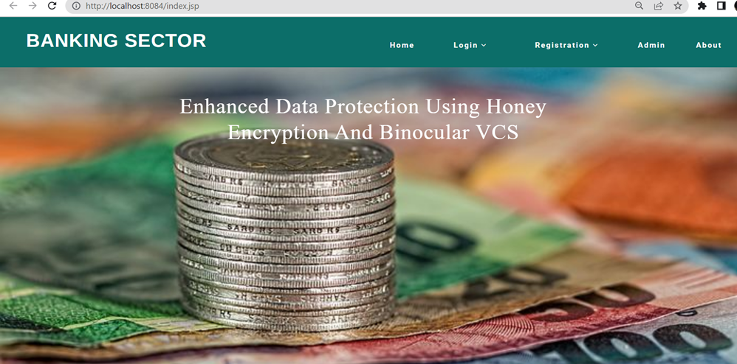
Screen Shots
Home Page

Slide 27
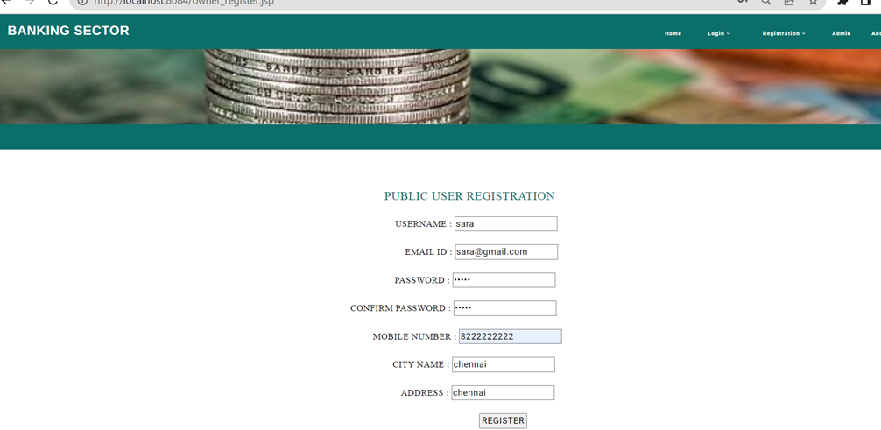
Screen Shots
Public User Registration

Slide 28
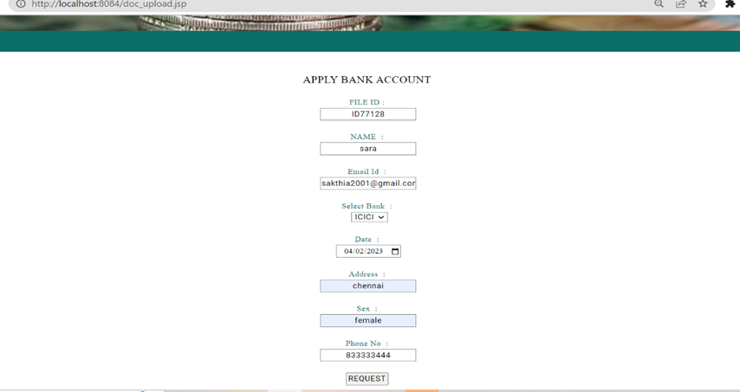
Screen Shots
Public User Login

Slide 29
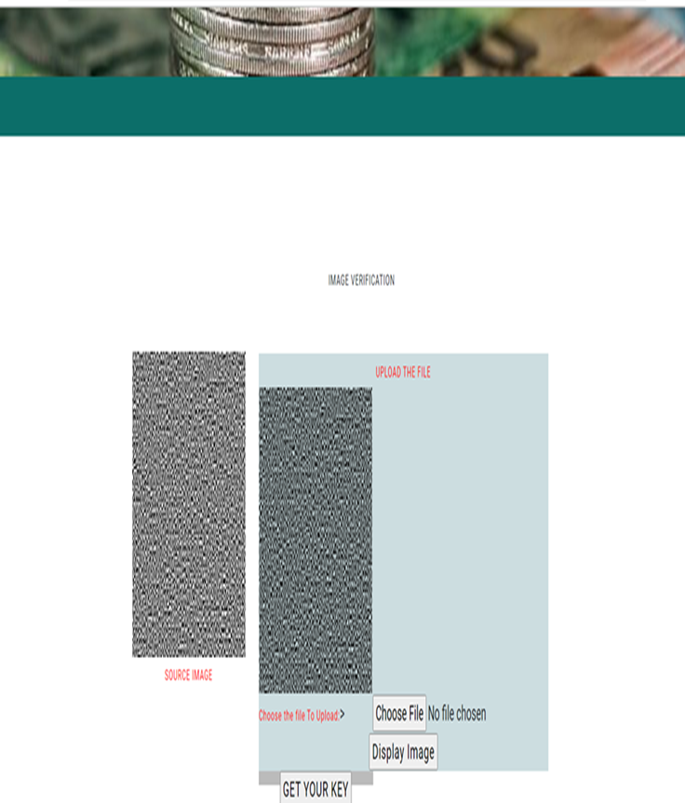
Screen Shots
Image Verification

Slide 30
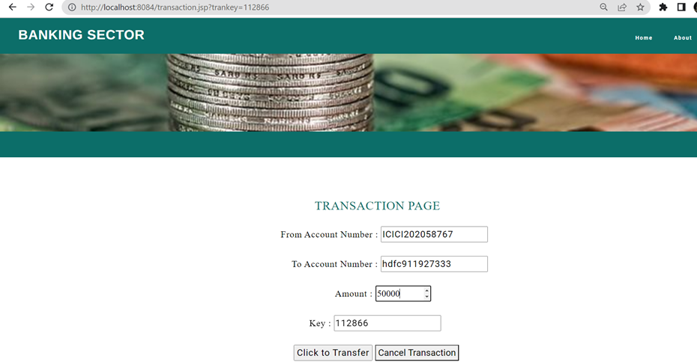
Screen Shots
Transaction Page

Slide 31
Conclusion & Future Enhancement
The primary benefit of the technology is the full synchronization of processes, as well as the integrity and uniqueness of all processed information, independent of mining or tokens.
Cloud-based technology aids in the improvement of distributed databases in terms of storage, synchronization, data loss, and data security.
As a result, the tool, when implemented in the Banking system without mining and tokens, will significantly simplify processes of maintaining the integrity and uniqueness of information on bank transactions

Slide 32
Reference Paper/ URL
[1 ] Roberto Vergallo and Luca Mainetti ,"The Role of Technology in Improving the Customer Experience in the Banking Sector: A Systematic Mapping Study" , 2022
https://sci-hub.ru/10.1109/tsp.2018.2883021
[2] Priya D. Dozier and Troy A. Montgomery ,"Banking on Blockchain: An Evaluation of Innovation Decision Making" ,2022
http://dx.doi.org/10.1109/TEM.2019.2948142http://dx.doi.org/10.1109/TEM.2020.2993171
[3]Mushtaq Ali , Amanullah Baloch , Abdul Waheed, "A Simple and Secure Reformation-Based Password Scheme", 2021
http://dx.doi.org/10.1109/ACCESS.2020.304905
[4] Yuanqiao chen , Xiaoqiang Zhang, Bomin Bian, and Haohua L ,"Optimal Staffing Policy in Commercial Banks Under Seasonal Demand Variation",2019
https://sci-hub.se/10.1109/access.2019.2937687
[5]João F. C. Rodrigues, Fernando A. F. Ferreira,"Banking Digitalization: (Re)Thinking Strategies and Trends Using Problem Structuring Method " ,2019
http://dx.doi.org/10.1109/TEM.2020.2993171

